Slide 1
Sustainability Study of Nackawic Elementary, Nackawic Middle and Nackawic High Schools
ss
September 29, 2015

Slide 2
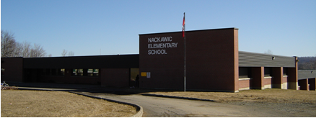
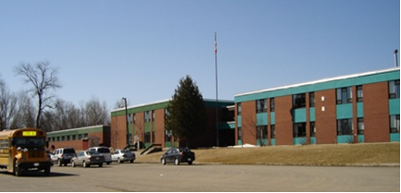
The Schools

Slide 3
Public Meeting #1 Agenda
Introductions
Review of Provincial Policy 409 Multi–Year School Infrastructure Planning
Presentation of Facts – Nackawic Schools
Question and Answer
What’s Next?
Online Resources and Feedback
Next Meetings

Slide 4
Provincial Policy 409: Multi-year School Infrastructure Planning
Outlines a number of responsibilities to do with facilities in our system
Sections 6.4, 6.5 and 6.6 are relevant for Sustainability Studies
Three Public Meetings
Meeting 1 – Presentation of Facts from District regarding the Schools (Policy 409 , 6.4. 4)
Meeting 2 - Presentation from Stakeholders regarding their thoughts on the sustainability of the schools and relevant factors
Meeting 3 – Final Review of Information by District Education Council (DEC) and subsequent motion on next steps
Not Designed as an “Us-Against-Them” process; public meetings are not designed to facilitate debate between two parties
Three Possible Outcomes
Status Quo
Recommendation to Minister for repairing the school(s)
Recommendation to Minister for closing the school(s) and placing students elsewhere

Slide 5
Presentations of Facts
Enrolment
Quality of Education Programs & Services
Provincial Assessment Results & Student Perception Results
Health & Safety Building Assessment
Transportation
Finances
Impact on Other Schools
Economic Development
Impact on the Local Community

Slide 6
Enrolment Nackawic Elementary School

Slide 7
Enrolment Nackawic Middle School

Slide 8
Enrolment Nackawic High School

Slide 9
Combined Enrolment – Nackawic Area Schools

Slide 10
Enrolment By Grade Level: Nackawic Schools
 | 2008 | 2009 | 2010 | 2011 | 2012 | 2013 | 2014 | 2015 Projected
K | 31 | 33 | 27 | 31 | 25 | 41 | 37 | 24
1 | 37 | 33 | 32 | 28 | 32 | 26 | 42 | 38
2 | 44 | 37 | 35 | 30 | 29 | 30 | 30 | 41
3 | 37 | 45 | 41 | 34 | 36 | 32 | 37 | 32
4 | 31 | 35 | 44 | 44 | 33 | 37 | 35 | 37
5 | 43 | 32 | 38 | 43 | 41 | 36 | 40 | 36
6(*) | 47 | 56 | 40 | 45 | 47 | 51 | 41 | 51
7 | 44 | 46 | 52 | 43 | 41 | 45 | 51 | 42
8 | 48 | 42 | 48 | 52 | 42 | 40 | 46 | 54
9(**) | 81 | 74 | 63 | 62 | 74 | 54 | 66 | 69
10 | 58 | 72 | 67 | 63 | 58 | 78 | 60 | 67
11 | 66 | 58 | 68 | 65 | 67 | 60 | 80 | 65
12 | 69 | 68 | 57 | 63 | 52 | 62 | 55 | 65
*Millville students join Nackawic schools in grade 6.
** Some Keswick Valley students join Nackawic schools in grade 9.

Slide 11
Projected Enrolment Nackawic Elementary School

Slide 12
Projected Enrolment Nackawic Middle School

Slide 13
Projected Enrolment Nackawic High School

Slide 14
Functional Capacity Nackawic Schools 2014-15
Functional Capacity Data | Student Enrollment | Number of Classrooms | Classrooms in Use | School Capacity | Capacity Rating
Nackawic Elementary School (Based on 24 students per class.) | 221 | 13 | 11 | 312 | 70.8%
Nackawic Middle School (Based on 29 students per class.) | 138 | 17 | 7 | 493 | 28.0%
Nackawic High School (Based on 29 students per class.) | 261 | 20 | 13 | 580 | 45.0%
Notes:
Functional Capacity provides data regarding the usage of classrooms within our schools. It is based on all spaces in a school that could be used for “homerooms.” In order to determine “functional capacity,” rooms are assigned maximum size based on grade level. Resource rooms, libraries, gymnasiums, pools, theatres, cafeterias, industrial and home economics facilities are not included. Functional Capacity is relevant in that it allows comparison of space utilization on a school by school basis.
The “rating” system for each school is an expression of the percentage of the space occupied when comparing the student population to the capacity of the building.
Greater than 80% - Full Capacity
60% to 80% - Optimum
Less than 60% - Under Utilized
30% or less – Triggered for Sustainability Study

Slide 15
Quality of Education Programs and Services The schools were staffed as follows:
Full Time Equivalent (FTE) 2015-16 | Nackawic Elementary School | Nackawic Middle School | Nackawic High School
Classroom Teachers | 13.1 FTE | 9.6 FTE | 16.4 FTE
Administration | 0.8 FTE | 0. 5 FTE | 1.1 FTE
Guidance | 0.5 FTE | 0.3 FTE | 0.75 FTE
Resource | 1.0 FTE | 0.8 FTE | 1.5 FTE
Total | 15.4 FTE | 11.2 FTE | 19.75 FTE
Notes:
Remember this is 2015-16 staffing.

Slide 16
Support Staff Information
Full Time Equivalent (FTE) 2015-16 | Nackawic Elementary School | Nackawic Middle School | Nackawic High School
Educational Assistants | 3.0 FTE | 5.0 FTE | 4 .0 FTE + 1.0 SIW
Administrative Assistant | 36.25 hrs per week (1.0FTE) | 36.25 hrs per week (1.0FTE) | 30 hrs per week for 10 months (0.82 FTE)
 |  |  | 36.25 hrs per week for 12 months (1.0FTE)
Library Assistant | 8.75 hrs per week (0.24FTE) | 5.75 hrs per week (0.16FTE) | NA
Custodian II | 40 hrs per week (1.0 FTE) | 40 hrs per week (1.0FTE) | 40 hrs per week (1.0FTE)
Custodian I | 48 hrs per week (1.2 FTE) | 60 hrs per week(1.5FTE) | 101 hrs per week (2.53FTE)
Notes:
Remember this is 2015-16 staffing.

Slide 17
Maximum class sizes
Grade Level | Maximum Number of Students
K-2 | 21
3 | 26
K-3 Combined Classes | 16
Grades 4-6 | 28
Grades 3 -5 Combined Classes | 23
Grades 7 to 12 | 29
Grades 5 to 12 Combined Classes | 24

Slide 18
Nackawic Elementary School Student: Teacher Ratio 2014-15
School | Year | Total Number Student: Teacher | Student: Teacher
Nackawic Elementary | 2014 - 2015 | 221 : 14.5 | 15.24: 1
Andover Elementary | 2014 - 2015 | 318 : 22.6 | 14.07:1
Meduxnekeag Consolidated | 2014 - 2015 | 411 : 29.3 | 14.02:1
Chipman Elementary | 2014 - 2015 | 104 : 8.0 | 13.00 : 1
2015-16 – There are currently 208 students at Nackawic Elementary School with a student : teacher ratio of 13.50:1 .

Slide 19
Nackawic Middle School Student: Teacher Ratio 2014-15
School | Year | Total Number Student: Teacher | Student: Teacher
Nackawic Middle | 2014 -2015 | 138 : 10.5 | 13.14 : 1
Woodstock Middle | 2014 -2015 | 402: 26.4 | 15.22 : 1
Florenceville Middle | 2014 -2015 | 194 : 14.6 | 13.28 : 1
Harold Peterson Middle | 2014 -2015 | 306 : 19:4 | 15.77 : 1
2015-16 – There are currently 147 students at Nackawic Middle School with a student : teacher ratio of
13.08 :1 .

Slide 20
Nackawic High School Student: Teacher Ratio 2014-15
School190 | Year | Total Number Student: Teacher | Student: Teacher
Nackawic High | 2014 -2015 | 261 : 19.0 | 13.73 :1
Woodstock High | 2014 -2015 | 596 : 40.5 | 14.71 : 1
Southern Victoria High | 2014 -2015 | 330 : 25.7 | 12.84 : 1
Fredericton High School | 2014 -2015 | 1909 : 115.7 | 16.50 : 1
2015-16 – There are currently 266 students at Nackawic High School with a student: teacher ratio of 13.66:1 .

Slide 21
Quality of Education Programs and Service
Grade 5 Students from Nackawic Elementary School enter Nackawic Middle School for Prime or French Immersion Programs, beginning in Grade 6. This is the last year for the late French Immersion program at Nackawic Middle School. Grade 5 students from Millville enter Nackawic Middle School for Grade 6 as well.
Grade 8 students from Nackawic Middle School feed into Nackawic High School for Grades 9-12. Approximately *40% of Grade 8 students from Keswick Valley Memorial School enter Nackawic High for grade 9 as well. French Immersion continues at Nackawic High.
* Based on review of enrolment data.

Slide 22
Class Size Comparisons 2014-2015
 | Minimum Class Size | Maximum Class Size | Average Class Size | Number of Classes 2014-15 | Number of Classes 2015-16
Nackawic Elementary | 15 | 25 | 20 | 11 | Minimum class size - 15 Maximum class size - 21 Average class size – 17 12
Andover Elementary | 17 | 25 | 20 | 16 | 15
Southern Carleton | 16 | 27 | 21 | 20 | 16 Meduxnekeag K-5
Chipman Elementary | 14 | 21 | 17 | 6 | 6
Nackawic Middle | 14 | 27 | 20 | 7 | Minimum class size - 8 Maximum class size - 26 Average class size – 16 9
Woodstock Middle | 16 | 26 | 22 | 18 | 8 Meduxnekeag 11 Townsview
Florenceville Middle | 15 | 25 | 19 | 10 | 11
Harold Peterson Middle | 20 | 26 | 24 | 13 | 14

Slide 23
Core Curriculum
 | Early French Immersion | Late French Immersion | Gymnasium | Music/Fine Arts Specialists | Educational Support Services | EST-Literacy | EST-Math | EST-Technology
Nackawic Elementary School | Yes | Yes | Yes | No | Yes | Yes | Yes | Request Support
Nackawic Middle School | Yes | Yes | Yes | Yes | Yes | No | Yes | Request Support
Nackawic High School | Yes | Yes | Yes | Yes | Yes | No | No | Request Support
 | EST-French ImmersionI | EST Science | Science Labs | Computer Lab | Computer Aided Drafted Lab (CAD) | Middle Level Technology | Broad Based Technology | Skills Trade Area | Distance Learning
Nackawic Elementary School | Yes | Yes | No | Yes | NA | NA | NA | NA | NA
Nackawic Middle School | Yes | Yes | Yes | Yes | NA | Yes | NA | Yes | NA
Nackawic High School | No | Yes | Yes | YES | Yes | NA | Yes | Yes | Yes

Slide 24
Impact on Other Schools
Beyond a decision of status quo or a recommendation to fix/upgrade the schools as they stand now, the following scenarios rise to the surface as possible considerations:
Creation of K-8 school within Nackawic Middle School as the site (with or without Millville Elementary School students pending outcome of sustainability study).
Creation of a 6-12 school within Nackawic High School as the site.
There does not appear to be capacity for a K-12 school in Nackawic with the current buildings. The construction of a new K-12 school serving 600-650 students would require government approval of a major capital construction project should it be recommended by the District Education Council.
It does not seem reasonable to consider moves to Fredericton, Harvey or Woodstock.

Slide 25
Scenario A: K-8 School
 | K-8 without Millville | K-8 with Millville
Projected 2016-17 enrolment | 329 (332) | 361 (360)
Projected 2016-17 number of homerooms | 18 | 18
Projected 2016-17 Functional Capacity | 74.4% | 81.7%
Projected 2016-17 Teacher FTE | 24.2 | 24.5

Slide 26
Scenario B: 6-12 School
Projected 2016-17 enrolment | 399
Projected 2016-17 number of homerooms | 7 Middle School Homerooms 265 High School Students
Projected 2016-17 Functional Capacity | 68.8%
Projected 2016-17 Teacher FTE | 29.4FTE

Slide 27
Special Events That Encourage Community School Partnerships at
Nackawic Elementary | Nackawic Middle | Nackawic High
Tae Kwon Do Presentations to physical education classes | Meals on Wheels | NHS Gives Back
School Breakfast for Community | Cross Country Ski Club | Garbage Pick up (Highway)
100th Day of School Food Drive for Food Bank | Breakfast For Learning | Entrepreneurship Farmer’s Market
ELF program with community members | Eco Classroom | Co-op Placements
For a complete listing of community school partnerships please view the schools annual reports posted on the ASD-W sustainability site at www.asd-w.nbed.nb.ca and follow the sustainability links.

Slide 28
Student Voice
Nackawic Elementary | Nackawic Middle | Nackawic High
Tell Them From Me Survey | Tell Them From Me Survey | Tell Them From Me Survey
Student Council/Children’s Parliament | Student Led Assemblies | Student Leadership
Peer Mediation | Think Tank | Cell Phone Policy Revision
Student Led Clubs | Student Council | Video Announcements
For a complete listing of opportunities for student voice please view the schools annual reports posted on the ASD-W sustainability site at www.asd-w.nbed.nb.ca and follow the sustainability links.

Slide 29
Provincial Assessment Results
Grade 2 Reading
Nackawic Elementary School
Grade 4 Reading
Nackawic Elementary School
Year | Nackawic Elementary | District | Province
2009-10 | 68.4% | 72.5% | 83.6%
2010-11 | 53.2% | 75.8% | 80.3%
2011-12 | 50% | 78% | 79.1%
2012-13 | 72.4% | 80.3% | 79.5%
2013-14 | 51.6% | 76.8% | 77.5%
Year | Nackawic Elementary | District | Province
2009-10 | 86.1% | 78.4% | 83.4%
2010-11 | 72.4% | 74.3% | 80.5%
2011-12 | 68.1% | 77.5% | 77.1%
Results not available after 2011-12 due to changes in the Provincial Assessment system.

Slide 30
Provincial Assessment Results
Grade 5 Numeracy Nackawic Elementary
Year | Nackawic Elementary | District | Province
2009-10 | 70.0% | 54.3% | 59.4%
2010-11 | 63.2% | 60.4% | 60.8%
2011-12 | 80.5% | 63.7% | 63.7%
2012-13 | 59.5% | 64.0% | 62.9%
*2013-14 | NA | 60.0% * | 59.4% *
* Based on a 20% sample of students.
30

Slide 31
Provincial Assessment Results
Grade 4 Reading French Immersion
Nackawic Elementary School
Grade 4 Writing French Immersion
Nackawic Elementary School
Year | Nackawic Elementary | District | Province
2010-11 | 35.3% | 41.0% | 64.0%
2011-12 | Pilot Year | Pilot Year | Pilot Year
2012-13 | 84.6% | 68.6% | 65.9%
2013-14 | 25.0% | 65.9% | 68.4%
Year | Nackawic Elementary | District | Province
2010-11 | 29.4% | 38.0% | 56.9
2011-12 | Pilot Year | Pilot Year | Pilot Year
2012-13 | 53.8% | 71.3% | 75.6%
2013-14 | 50.0% | 56.2% | 63.8%

Slide 32
Provincial Assessment Results
Grade 7 Reading
Nackawic Middle School
Grade 7 Writing
Nackawic Middle School
Year | Nackawic Middle | District | Province
2009-10 | 60.9% | 61.6% | 66.9%
2010-11 | 57.7% | 65.1% | 69.8%
2011-12 | 77.3% | 67.7% | 69.4%
2012-13 | 82.5% | 74.5% | 76.2%
2013-14 | 91.1% | 77.8% | 77.1%
Year | Nackawic Middle | District | Province
2009-10 | 54.3% | 50.6% | 51.9%
2010-11 | 50.0% | 50.2% | 53.1%
2011-12 | 63.6% | 60.8% | 64.5%
2012-13 | 72.5% | 59.7% | 62.6%
2013-14 | NA | 52.9%* | 59.7%*
* Based on a 20% sample of students

Slide 33
Provincial Assessment Results
Grade 8 Numeracy Nackawic Middle School
Year | Nackawic Middle | District | Province
2009-10 | 52.4% | 59.7% | 59.3%
2010-11 | 52.0% | 53.9% | 57.6%
2011-12 | 41.2% | 52.6% | 57.5%
2012-13 | 57.5% | 53.6% | 58.5%
2013-14 | 73.7% | 49.5% | 57.6%

Slide 34
Provincial Assessment Results
Grade 9 English Language Proficiency - Reading
Nackawic High School
Grade 9 English Language Proficiency - Writing
Nackawic High School
Year | Nackawic High | District | Province
2009-10 | 71.0% | 59.0% | 65.3%
2010-11 | 76.4% | 71.4% | 72.5%
2011-12 | 77.8% | 73.5% | 73.5%
2012-13 | 71.4% | 78.6% | 78.1%
2013-14 | 87.0% | 80.4% | 80.4%
Year | Nackawic High | District | Province
2009-10 | 76.8% | 78.2% | 77.9%
2010-11 | 69.1% | 82.3% | 78.9%
2011-12 | 81.5% | 84.6% | 82.1%
2012-13 | 77.8% | 83.2% | 82.4%
2013-14 | 95.6% | 89.5% | 88.2%

Slide 35
Provincial Assessment Results
Grade 10 French Second Language Reading
Nackawic High School
Grade 10 French Second Language Writing Nackawic High School
Year | Nackawic High | District | Province
2009-10 | 100.0% | 81.2% | 80.3%
2010-11 | 82.4% | 74.8% | 77.7%
2011-12 | NA | 81.4% | 78.4%
2012-13 | 80.0% | 85.2% | 78.3%
2013-14 | 72.7% | 85.8% | 80.1%
Year | Nackawic High | District | Province
2009-10 | 66.7% | 44.3% | 40.8%
2010-11 | 41.2% | 36.6% | 39.8%
2011-12 | NA | 52.2% | 46.4%
2012-13 | 50.0% | 47.2% | 36.2%
2013-14 | 36.4% | 54.8% | 47.2%

Slide 36
Student Perception Data
Nackawic Elementary | Nackawic Middle | Nackawic High
84% of students reported that they feel accepted and valued by peers and others in the building, contributing to a positive sense of belonging. *Canadian Norm - 86% | 76% of students reported that they feel accepted and valued by peers and others in the building, contributing to a positive sense of belonging. Canadian Norm - 75% | 57% of students reported that they feel accepted and valued by peers and others in the building, contributing to a positive sense of belonging. *Canadian Norm- 70%
76% of students reported that they feel safe attending their school, as well as going to and from school. * Canadian Norm- 69% | 65% of students reported that they feel safe attending their school, as well as going to and from school. Canadian Norm - 66% | 55% of students reported that they feel safe attending their school, as well as going to and from school. * Canadian Norm- 65%
93% of students reported that they value school outcomes and the importance of education to their future. * Canadian Norm- 96% | 86% of students reported that they value school outcomes and the importance of education to their future. Canadian Norm - 85% | 64% of students reported that they value school outcomes and the importance of education to their future. *Canadian Norm- 69%
92% of students reported that they were interested and motivated in their learning. * Canadian Norm – 74% | 52% of students reported that they were interested and motivated in their learning. * Canadian Norm – 42% | 28% of students reported that they were interested and motivated in their learning. * Canadian norm -28%
For a complete review of the school based Tell Them From Me Reports please visit the ASD-W sustainability site at www.asd-w.nbed.nb.ca and follow the sustainability links.

Slide 37
Nackawic Elementary School (NES) General Information - Facility Review
The school has 13 rooms that are defined as classrooms.
Corridor and classroom walls are masonry block.
Ceilings are cedar in classrooms with a suspended tee bar in the corridors.
The building is equipped with a fire alarm system.
Fire extinguishers are located throughout the building and fire alarm pull stations are located in corridors.

Slide 38
NES Floor Plan

Slide 39
NES Building Summary
Constructed in 1967.
Renovations have included:
Piece added to building in 1987.
Three ventilation units upgraded in 2005.
Roof replacement 2010/2011.

Slide 40
NES Building Summary
There is a cafeteria in the school.
Windows are in fair to poor condition.
There is a lift for physically disabled persons.
Interior doors are wood and are fire rated.
Washrooms are in good condition.
Gym floor is hardwood in good condition.

Slide 41
NES Electrical & Lighting
Electrical entrance is 800 amps, 347/600 volt 3 phase in good condition, there is capacity available for additional circuits.
Interior lighting is fluorescent in fair condition in original section and in good condition in newer section.
The building has a Public Address system.

Slide 42
NES Exterior
Exterior doors are in good condition.
The exterior cladding is brick and in good condition.
Parking is adequate, pavement is in poor condition.
Three exterior light poles, and light fixtures on the side of school.
There are two play ground areas with adequate play structures, and a soccer field.

Slide 43
NES Property
Staff and visitors share the school parking lot.
The driveway is shared by the bus loading zone and parent drop off.

Slide 44
NES Capital Investments
Year | Scope of Work | Cost
2010/2011 | Roof replacement | $221,969.00
September 2015

Slide 45
NES School Physical Plant Status
Building Exterior and Site |  | Description | Estimated Cost
Building Envelope | Exterior doors | Automatic door openers
Building Envelope | Exterior Windows | Window replacement
Site | Site Improvement | Upgrade bus/parent drop off zone at rear of building
September 2015

Slide 46
NES School Physical Plant Status
Building Interior and Additions |  | Description | Estimated Cost
Interior Finishes | Floors | Re- Tile floors,7 classrooms (to be reviewed) | NO LONGER REQUIRED
Electrical | Electrical Maintenance | Electrical Transformer cleaning
 |  | Total Estimated Cost | $280,000.00

Slide 47
Nackawic Middle School (NMS) General Information – Facility Review
The school has 17 rooms that are defined as classrooms.
Corridor and classroom walls are masonry block.
Ceilings suspended tee bar.
The building is equipped with fire alarm system.
Fire extinguishers are located throughout the building and fire alarm pull stations are located in corridors.

Slide 48
NMS Bottom Floor

Slide 49
NMS Middle Floor

Slide 50
NMS Top Floor

Slide 51
NMS Building Summary
Constructed in 1971.
Renovations have included:
Some widows upgraded in 1998.
Roof- replaced a portion in 2005, 2012 and in 2014.

Slide 52
NMS Building Summary
There is a cafeteria in the school.
Exterior doors are in good to fair condition.
Windows are in good to fair condition.
There is a Whirltech lift for physically disabled persons.
Interior doors are fire rated with panic hardware where appropriate.
Washrooms are in good condition.
Gym floor is hardwood in good condition.

Slide 53
NMS Electrical & Lighting
Electrical entrance is 4000 amps, 120/208 volt 3 phase in good condition with a capacity for additional circuits .
Interior lighting is fluorescent in good condition.
The building has a Public Address system.
Heating is electric baseboard along with cabinet and duct heaters.

Slide 54
NMS Exterior
The exterior is brick in good condition.
Parking is adequate, pavement in good condition.
3 exterior lighting is H.I.D. (high intensity discharge)
Play ground has swing set, outdoor fitness equipment and a shared soccer field with Nackawic High School.

Slide 55
NMS Property
Staff and visitors share the school parking lot.
The driveway is shared by the bus loading zone and parent drop off.

Slide 56
NMS Capital Investments
Year | Scope of Work | Cost
2012/2013 | Roof replacement | $131,879.00
2013/2014 | Roof Replacement | $110,664.00
 |  | Total = $242,543.00

Slide 57
NMS School Physical Plant Status
Building Exterior and Site |  | Description | Estimated Cost
Building Envelope | Exterior doors | Automatic door openers and doors
Building Envelope | Exterior Walls | Brick re-pointing
Building Envelope | Exterior Walls | Refinish Metal Siding
Building Envelope | Exterior Windows | Window replacement

Slide 58
NMS School Physical Plant Status (continued)
Building Exterior |  | Description | Estimated Cost
Building Envelope | Roofs | Roof recapping and repairs
Site | Site Improvement | Driveway repair
Site | Site Improvement | Paving

Slide 59
School Physical Plant Status (continued)
Building Interior | Description |  | Estimated Cost
Interior Finishes | Floors | Floor replacements
Heating and Ventilation | Ventilation System | To upgrade air handling units in the office end of the school.
 |  | Total | $630,000.00

Slide 60
Nackawic High School (NHS) General Information – Facility Review
The school has 20 rooms that are defined as classrooms.
Corridor and classroom walls are masonry block.
Ceilings are suspended tee bar.
The building is equipped with fire alarm system.
Fire extinguishers are located throughout the building and fire alarm pull stations are located in corridors.
Stairways are enclosed to meet fire separation requirements.

Slide 61
NHS General Information
There is a cafeteria in the school.
Exterior doors are in poor condition; some may be classified as fair.
Windows are in fair condition in the newer part of the facility.
There is a Whirltech lift for physically disabled persons.
Interior doors are fire rated with panic hardware where appropriate.
Washrooms are in fair condition, including locker rooms.
Gym floor is hardwood ( new 2015).

Slide 62
NHS Main Floor

Slide 63
NHS Top Floor

Slide 64
NHS Top Floor

Slide 65
NHS Building Summary
Constructed in 1967.
Renovations have included:
Classrooms added in 1997.
Radon remediation 2012/2013.
Electrical service entrance added 2009/2010.

Slide 66
NHS Electrical & Lighting
Electrical entrance is 4000 amps, 347/600 volt 3 phase in good condition.
Interior lighting is fluorescent in fair condition.
Exterior lighting is H.I.D ( high intensity discharge).
There are 4 room ventilation units (HVAC) as well as 12 exhaust fans.
The building has a Public Address system; may require upgrades.
Heating is electric baseboard along with cabinet and duct heaters.
Building Management system controls for ventilation and heating.

Slide 67
NHS Exterior
The exterior is brick and in good condition. On the exterior of the addition the cladding requires repairs.
Parking is adequate, pavement in good condition.

Slide 68
NHS Property
Staff and visitors share the school parking lot.
The driveway is shared by the bus loading zone and parent drop off.
There is a woodlot property managed by the school and owned by the province under the name of the school; used for curricular purposes.

Slide 69
NHS Capital Investments
Year | Scope of Work | Cost
2009/2010 | Electrical service entrance | $69,243.00
2012/2013 | Radon Remediation | $66,319.00
 |  | Total = $135,562.00

Slide 70
NHS School Physical Plant Status
Building Exterior and Site |  | Description | Estimated Cost
Building Envelope | Exterior doors | 14 Exterior doors
Building Envelope | Exterior Doors | Automatic door openers
Building Envelope | Exterior Walls | Brick Repointing
Site | Site Improvement | Parking Lot

Slide 71
NHS School Physical Plant Status (continued)
Building Exterior |  | Description | Estimated Cost
Site | Landscape | Lawn Repair
Site | Playfield | Sports Field
Heating and Ventilation | Ventilation System | Complete Ventilation System.
 |  |  | Total – $2,038,000.00

Slide 72
Nackawic Transportation Study
Currently students in grades K-12 ( and those enrolled in French Immersion in grades 3-8 that reside in the Millville Elementary School and Keswick Valley School Catchment areas) are bused to the Nackawic Schools, outside the bus free walking zone in the residential area surrounding the schools.
The morning school bus system currently sees eleven buses transport students within the Nackawic Middle/High School Catchment into the three area Nackawic Schools.

Slide 73
Nackawic Transportation Study Continued
The afternoon school bus system currently sees eleven buses transport students residing within the Nackawic Middle/High School Catchment area (includes all three schools).
There would not be any impact with regards to the number of school buses or drivers if one of the Nackawic Schools should close and the students remained in the Town of Nackawic. However, there would be a reduction in kilometers travelled by the school buses.
It has been noted that more students from Keswick Valley Memorial School catchment area could be considered for Nackawic High School as opposed to Leo Hayes High School.
September 2015

Slide 74
Nackawic Transportation Study Continued
School | Longest Ride In | Longest Ride Out | Earliest Pick-up | Latest Drop Off | Average Ride Time
Nackawic Elementary School | 50 mins | 54 mins | 7:34a.m. | 3:50p.m. | 28 mins
Nackawic Middle School | 68 mins | 63 mins | 7:18a.m. | 3:50p.m. | 32 mins
Nackawic High School | 75 mins | 75 mins | 7:05a.m. | 4:08p.m. | 34 mins

Slide 75
Current Student Address Distances
 | Distance to Nackawic Elementary School (KM)
Average Distance | 9.4
Maximum Distance | 36.2
Minimum Distance | 0.1

Slide 76
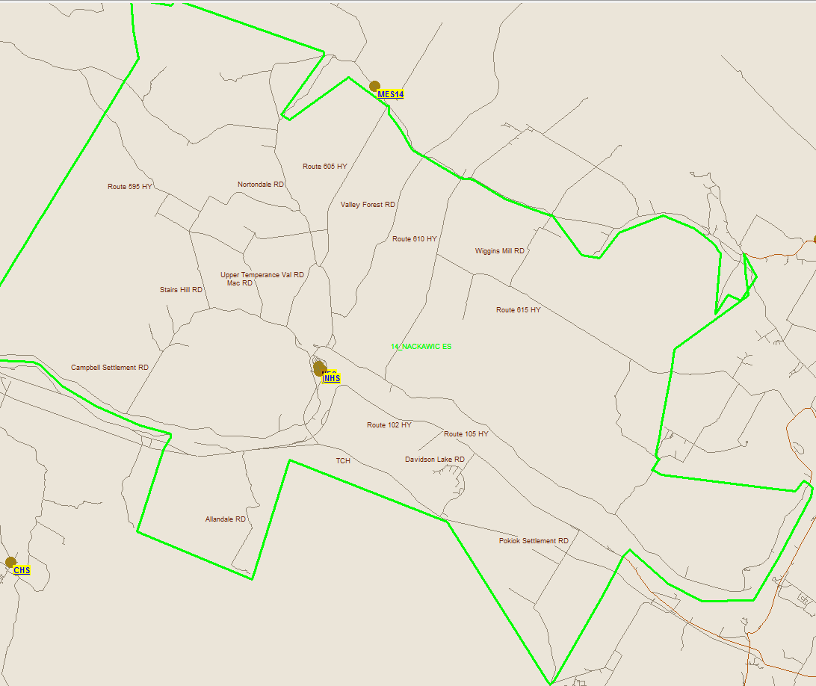
Nackawic Elementary Boundary
76

Slide 77
Current Student Address Distances
 | Distance to Nackawic Middle School (KM)
Average Distance | 10.8
Maximum Distance | 36.5
Minimum Distance | 0.1

Slide 78
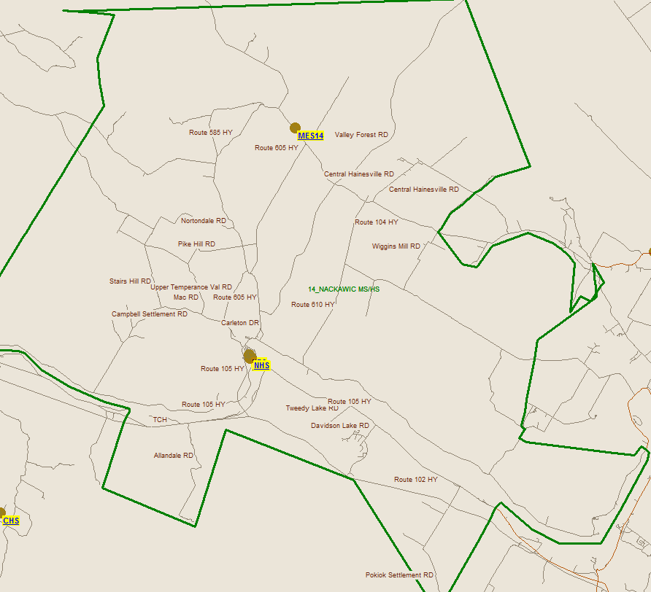
Nackawic Middle Boundary
78

Slide 79
Current Student Address Distances
 | Distance to Nackawic High School (KM)
Average Distance | 15.3
Maximum Distance | 42.2
Minimum Distance | 0.1

Slide 80
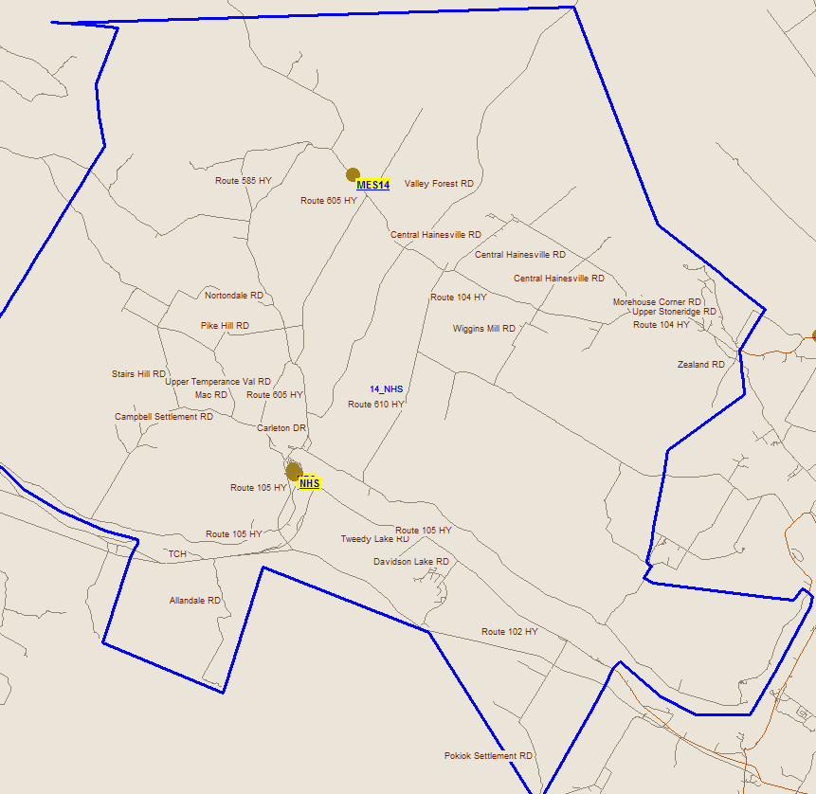
Nackawic High Boundary
80

Slide 81
Salaries Nackawic Elementary
 | Actual Costs
Cost Centers | Fiscal Year | Fiscal Year | Fiscal Year
 | 2014-2015 | 2013-2014 | 2012-2013
Salaries
Administration | 18,766 | 18,464 | 16,419
Teacher | 1,042,850 | 1,044,183 | 1,016,323
Admin. Assistant | 31,776 | 30,761 | 30,340
Educational Assistant | 92,806 | 121,999 | 158,216
Custodian | 73,071 | 72,701 | 70,575
Total | 1,259,269 | 1,288,108 | 1,291,873

Slide 82
NES Assigned Budgets
 | Actual Costs
Cost Centers | Fiscal Year | Fiscal Year | Fiscal Year
 | 2014-2015 | 2013-2014 | 2012-2013
Assigned Budgets
Regular Instruction | 16,754 | 17,520 | 19,476
Admin.Support | 4,313 | 4,323 | 4,293
Library | - | - | -
Teachers Working Conditions | 2,494 | 2,467 | 4,889
EAL Tutor Support | 720 | 600 | -
Nutrition | 1,876 | 1,830 | 3,444
Bilingual Learning Environ. | - | 400 | 400
Wellness Grant | 1,463 | 600 | 427
Co/Extra Trips | 908 | 910 | 904
PSSC | 609 | 585 | 678
Total | 29,137 | 29,235 | 34,511

Slide 83
NES Facilities Costs
 | Actual Costs
Cost Centers | Fiscal Year | Fiscal Year | Fiscal Year
 | 2014-2015 | 2013-2014 | 2012-2013
Facilities Costs
Electricity | 56,951 | 53,210 | 51,826
Water and Sewer | 12,576 | 12,622 | 8,515
Garbage Removal | 3,428 | 2,500 | 2,500
Ground Maintenance | 8,021 | 8,990 | 8,990
Cleaning Supplies | 2,814 | 3,338 | 2,864
Minor Repairs | 5,231 | 1,620 | 6,763
Total | 89,021 | 82,280 | 81,458

Slide 84
Total Costs-Nackawic Elementary
 | Actual Costs
Cost Centers | Fiscal Year | Fiscal Year | Fiscal Year
 | 2014-2015 | 2013-2014 | 2012-2013
TOTAL COSTS | 1,377,427 | 1,399,623 | 1,407,842

Slide 85
Salaries-Nackawic Middle School (NMS)
 | Actual Costs
Cost Centers | Fiscal Year | Fiscal Year | Fiscal Year
 | 2014-2015 | 2013-2014 | 2012-2013
Salaries
Administration | 12,510 | 15,004 | 19,849
Teacher | 874,621 | 860,490 | 894,531
Admin. Assistant | 28,651 | 18,406 | 25,220
Educational Assistant | 55,704 | 37,419 | 28,931
Custodian | 99,126 | 108,388 | 94,443
Total | 1,070,612 | 1,039,707 | 1,062,974

Slide 86
NMS Assigned Budgets
 | Actual Costs
Cost Centers | Fiscal Year | Fiscal Year | Fiscal Year
 | 2014-2015 | 2013-2014 | 2012-2013
Assigned Budgets
Regular Instruction | 13,564 | 15,314 | 19,990
Admin.Support | 3,594 | 3,692 | 3,902
Library | - | - | -
Teachers Working Conditions | 2,079 | 2,175 | 6,387
Nutrition | - | - | -
Bilingual Learning Environ. | 350 | 350 | 350
Wellness Grant | 1,683 | 1,666 | 1,680
Co/Extra Trips | 757 | 777 | 821
PSSC | 410 | 388 | 616
Total | 22,437 | 24,362 | 33,746

Slide 87
NMS Facilities Costs
 | Actual Costs
Cost Centers | Fiscal Year | Fiscal Year | Fiscal Year
 | 2014-2015 | 2013-2014 | 2012-2013
Facilities Costs
Electricity | 77,132 | 74,642 | 68,248
Water and Sewer | 10,928 | 9,376 | 14,398
Garbage Removal | 3,041 | 2,940 | 2,940
Ground Maintenance | 9,375 | 9,834 | 9,834
Cleaning Supplies | 1,467 | 2,342 | 1,935
Minor Repairs | 7,763 | 10,726 | 5,212
Total | 109,706 | 109,860 | 102,567

Slide 88
Total Costs-Nackawic Middle School
 | Actual Costs
Cost Centers | Fiscal Year | Fiscal Year | Fiscal Year
 | 2014-2015 | 2013-2014 | 2012-2013
TOTAL COSTS | 1,202,755 | 1,173,929 | 1,199,287

Slide 89
Salaries-Nackawic High School (NHS)
 | Actual Costs
Cost Centers | Fiscal Year | Fiscal Year | Fiscal Year
 | 2014-2015 | 2013-2014 | 2012-2013
Salaries
Administration | 23,962 | 23,576 | 23,467
Teacher | 1,465,172 | 1,438,670 | 1,337,836
Admin. Assistant | 42,375 | 44,055 | 57,833
Educational Assistant | 92,554 | 96,563 | 72,048
Custodian | 128,481 | 103,885 | 105,018
Total | 1,752,544 | 1,706,749 | 1,596,202

Slide 90
NHS Assigned Budgets
 | Actual Costs
Cost Centers | Fiscal Year | Fiscal Year | Fiscal Year
 | 2014-2015 | 2013-2014 | 2012-2013
Assigned Budgets
Regular Instruction | 26,601 | 29,734 | 41,676
Admin.Support | 7,062 | 7,251 | 7,659
Library | - | - | -
Teachers Working Conditions | 2,876 | 2,846 | 7,833
Nutrition | - | - | -
Bilingual Learning Environ. | - | 500 | 500
Wellness Grant | 1,933 | 1,904 | 1,909
Co/Extra Trips | 1,487 | 1,526 | 1,612
PSSC | 766 | 748 | 1,209
Total | 40,725 | 44,509 | 62,398

Slide 91
NHS Facilities Costs
 | Actual Costs
Cost Centers | Fiscal Year | Fiscal Year | Fiscal Year
 | 2014-2015 | 2013-2014 | 2012-2013
Facilities Costs
Electricity | 118,894 | 117,364 | 105,613
Water and Sewer | 13,309 | 14,064 | 11,978
Garbage Removal | 4,868 | 4,100 | 4,100
Ground Maintenance | 9,375 | 9,834 | 9,834
Cleaning Supplies | 3,266 | 3,377 | 3,042
Minor Repairs | 8,248 | 8,366 | 10,109
Total | 157 ,960 | 157,105 | 144,676

Slide 92
Total Costs-Nackawic High School
 | Actual Costs
Cost Centers | Fiscal Year | Fiscal Year | Fiscal Year
 | 2014-2015 | 2013-2014 | 2012-2013
TOTAL COSTS | 1,951,229 | 1,908,363 | 1,803,276

Slide 93
Economic Development
Based on consultations with the following:
Representatives of the Nackawic Town Council
Chief Administrative Officer

Slide 94
Nackawic Community
2013 Population (Town Only) -- 1044
Land Mass -- 8.45 km²
Population density -- 123.3 people/km²
Pop surrounding area App. 7000
Language usage -- 90% English
Ratio male/female -- 50/50
% of population under 19 -- 27%
% pop 20-54 -- 48%
% pop 54-65 -- 15%
% pop +65 -- 10%
Total Private Dwellings -- 426
Average family income -- $65,982.00

Slide 95
Nackawic Location

Slide 96
Nackawic Emergency Services

Slide 97
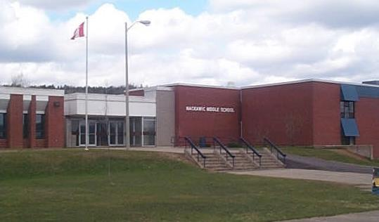
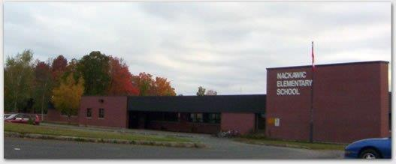
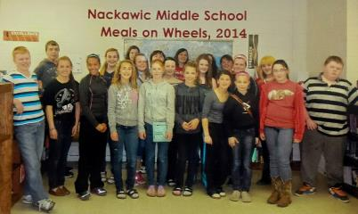
Nackawic Gets Involved

Slide 98
Nackawic Employers
AV Nackawic
A1 Detailing
Canada Post
CIBC
Department of Education
Department of Transportation and Infrastructure
Irving
Mycon
Nackawic Health Center
Napa Auto Parts
North York Industries
Peoples Choice Pharmacy
Pizza Twice
Robin’s Donuts/Captain Sub
Ryan’s Pharmacy
Saigon Garden
Scotia Bank
Subway
The Dollar Store
Topmar Building Supply
Town of Nackawic
Your Independent Grocer

Slide 99
Impact on the Community of Nackawic
Community currently enjoys three educational facilities which naturally separates elementary, middle and high school students. Grade configurations in schools may have an impact on family perception of quality education; would this result in relocation?
Close community ties between the schools and local service groups.
Potential for reciprocal agreements with interested community stakeholders in available space within school(s).
Slight loss in employment opportunities within the school system within the town.
Does the Sisson Brook Exploration scenario require a closer look?
Future of vacant building would be unknown and could have a positive or negative impact on the community.
Public meeting # 2 will explore this impact further, as experts and stakeholders from the community share their thoughts .

Slide 100
Questions and Answers

Slide 101
Nackawic Schools Sustainability Study – Visit our Website for Details!
Sustainability Study Timeline
Minister Letters
Parent Letters
Schools at a Glance: Nackawic Elementary, Nackawic Middle and Nackawic High
Link to Policy 409
Public Meeting #1 – Presentation
www.asd-w.nbed.nb.ca
Feedback can be given
via email at asdwsustainability@nbed.nb.ca
through our discussion board at the Nackawic Schools Sustainability Study site on our webpage
mail to Carol Clark-Caterini, Anglophone West School District, 1135 Prospect Street, Fredericton, NB E3B-3B9
Notes:
Reminder of what “sustainability” means:
Maintain the status-quo
Invest dollars into the infrastructure/programming
Close a school and move the students to another school for their continued education

Slide 102
Thank you for coming!

